Slide 1
UNIT IV
Capital Budgeting

Slide 2
Outcomes
Appraise the concept of capital budgeting and analyse pay back period method of capital budgeting.

Slide 3
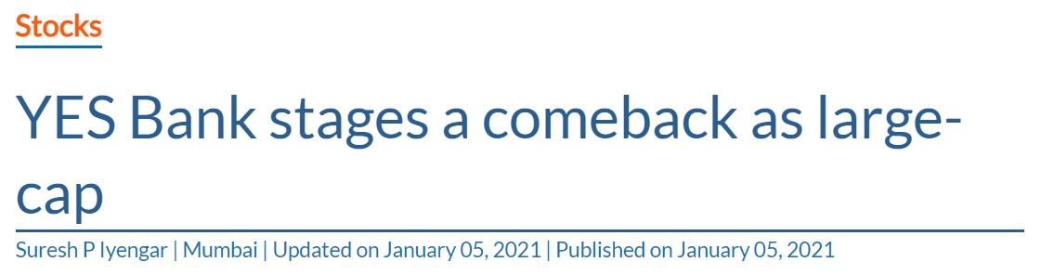
News Analysis
https://www.thehindubusinessline.com/markets/stock-markets/yes-bank-stages-a-comeback-as-large-cap/article33503757.ece?homepage=true

Slide 4
Capital Budgeting
The investment decisions of a firm are generally known as the capital budgeting/capital expenditure decisions. A capital budgeting decision may be defined as the firm’s decision to invest its current funds most efficiently in the long term assets in anticipation of an expected flow of benefits over a series of years.
The firms decisions generally include expansion, acquisition, modernization and replacement of long term assets. Sale of a division/business (divestment) is also as an investment decision.

Slide 5
Features of Capital Budgeting decisions
The following are the features of investment decisions:
The exchange of current funds for future benefits.
The funds are invested in long term assets.
The future benefits will occur to the firm over a series of years.
It is significant to emphasize that expenditures and benefits of an investment should be measured in cash. In the investment analysis, it is cash flow, which is important, and not the accounting profit.

Slide 6
MCQ
Capital budgeting is the process of identifying analyzing and selecting investments project whose returns are expected to extend beyond ____________________?
3 years
5 years
1 year
None of the above

Slide 7
Answer
C. 1 year

Slide 8
Importance of Capital budgeting decisions
Investment decisions require special attention because the following reasons:
They influence the firm’s growth in the long run.
They affect the risk of the firm.
They involve commitment of large amount of funds.
They are irreversible, or reversible at substantial loss.
They are among the most difficult decisions to make.

Slide 9
Investment Evaluation Techniques
A number of investment criteria (or capital budgeting techniques) are in use in practice. They may be grouped in the following two categories:
1. Discounted Cash Flow (DCF) Criteria
Net present value (NPV)
Internal rate of return (IRR)
Profitability index (PI)
2. Non-discounted Cash Flow Criteria
Payback (PB)
Accounting rate of return (ARR).

Slide 10
MCQ
……………….. describes the firm's formal planning process for the acquisition and investment of capital.
Financial planning
Capital structure
Capital budgeting
None of the above

Slide 11
Answer
C. Capital budgeting

Slide 12
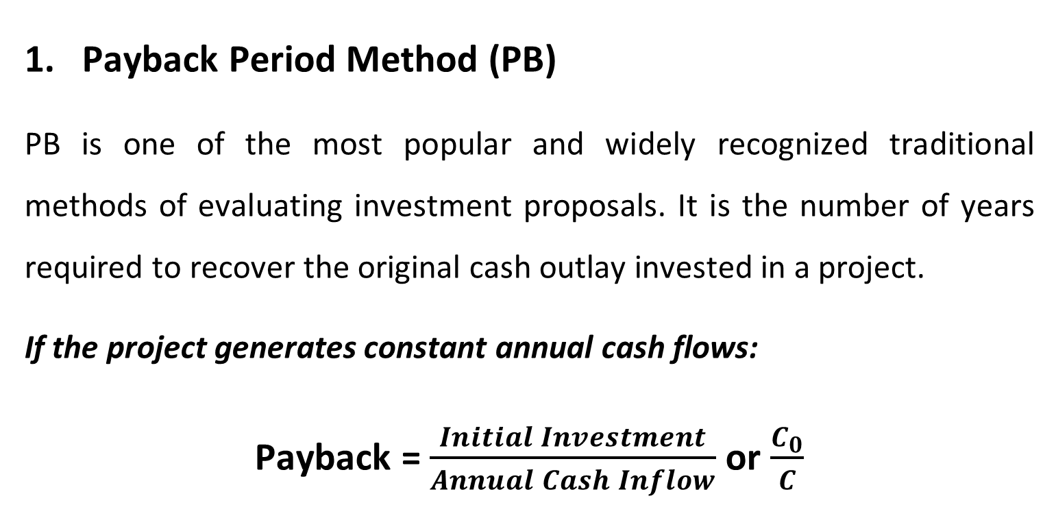
Non-discounted Capital budgeting techniques

Slide 13
Illustration
Assume that a project requires an outlay of ₹ 50,000 and yields annual cash inflow of ₹ 12,500 for 7 years. The payback period for the project is?
5 years
6 years
4 years
None of the above

Slide 14
Uneven Cash Flows (PB)
In case of unequal cash inflows, the PB can be found out by adding up the cash inflows until the total is equal to the initial cash outlay.
Illustration
Suppose that a project requires a cash outlay of ₹ 20,000, and generates cash inflows of ₹ 8,000; ₹ 7,000; ₹ 4,000; and ₹ 3,000 during the next 4 years. What is the project’s payback?

Slide 15
MCQ
The span of time within which the investment made for the project will be recovered by the net returns of the project is known as
(A) Period of return
(B) Payback period
(C) Span of return
(D) None of the above

Slide 16
Answer
(B) Payback period

Slide 17
Acceptance Rule for Pay Back Period
Many Firm’s use this technique and compare the project’s payback with predetermined, standard payback. The project would be accepted if its payback period is less than the maximum or standard payback period set by management.
As ranking method it gives highest ranking to the project, which has shortest payback period and lowest ranking to the project with highest payback period.

Slide 18
Advantage of Pay Back Method
Payback is a popular investment criterion in practice. It is considered to have certain virtues.
Simplicity
Cost effective
Short-term effects
Liquidity
Risk shield

Slide 19
MCQ
Which of the following is an example of a capital investment project?
a. Replacement of worn out equipment
b. Expansion of production facilities
c. Development of employee training programs
d. All of the above are examples of capital investment projects.

Slide 20
Answer
d. All of the above are examples of capital investment projects.

Slide 21
Criticism of Pay Back Period Method
Cash flows after payback
Payback fails to take account of the cash inflows earned after the payback period.
Administrative difficulties
A firm may face difficulties in determining the maximum acceptable payback period. There is no rational basis for setting a maximum payback period. It is generally a subjective decision.

Slide 22
Contd….
Cash flow patterns
Payback fails to consider the pattern of cash inflows, i.e., magnitude and timing of cash inflows. In other words, it gives equal weights to returns of equal amounts even though they occur in different time periods.
Inconsistent with shareholder value
Payback is not consistent with the objective of maximizing the market value of the firm’s shares. Share values do not depend on payback periods of investment projects.

Slide 23
MCQ
An asset costs $210,000 with a $30,000 salvage value at the end of its ten-year life. If annual cash inflows are $30,000, the cash payback period is
a) 8 years.
b) 7 years.
c) 6 years.
d) 5 years.

Slide 24
Answer
b) 7 years.

